Slide 1
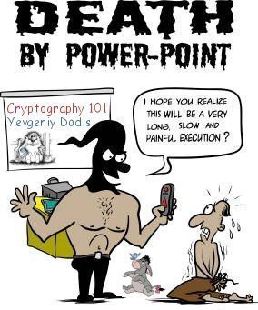
The End

Slide 2
<Rant>

Slide 3
10 Things I Wish I Learned In College
Or just before I had to learn the hard way I didn’t know them.

Slide 4
Wayne Odom
Software Development Project Lead at Turner Industries Group, L.L.C.
Graduated From LSU in 2002 in Computer Science
Have Interviewed More Software Developers and DBAs Than Can Be Remembered
4 |

Slide 5
Software at Turner
Heavy Industrial Constructor. Turnarounds, Maintenance, Fabrication, Heavy Equipment, Man Power, Services
Our planning teams require lots of highly adaptable software solutions to getting information.
5 |

Slide 6
Don’t Take Notes
All Sides at www.wayneodom.com

Slide 7
Alternative Titles….
10 Things Any IT Pro Should Know
10 Things I Wish I Learned Before That Embarrassing Interview
10 Things Wayne Thinks Are Important

Slide 8
Catalyst For This Talk
I’ve interviewed a lot of people in the last 2 years. Developers & DBAs
I have a few younger family and friends graduating.
I personally experienced learning what I didn’t learn in college the hard way.

Slide 9
Just My Opinion
Could be wrong about a lot of it.
Probably most helpful to those wishing to stay in Baton Rouge.
Seems to work out so far.
I do realize colleges don’t seem to care about getting a job. All about learning.
I would like to see a variation of this talk as a college course.

Slide 10
My 10 Things Very Quickly
I Wish I Learned Practical Communication Skills
I Wish I Learned Resume Writing, Interviewing
I Wish I Learned Regionally Significant Topics
I Wish I Learned To Research Constantly.
I Wish I Learned Basic Project Management
I Wish I Learned Design First
I Wish I Learned Design Patterns
I Wish I Learned More On Testing
I Wish I learned about user id from the first
I wish I Learned Not to Re-Invent the Wheel.

Slide 11
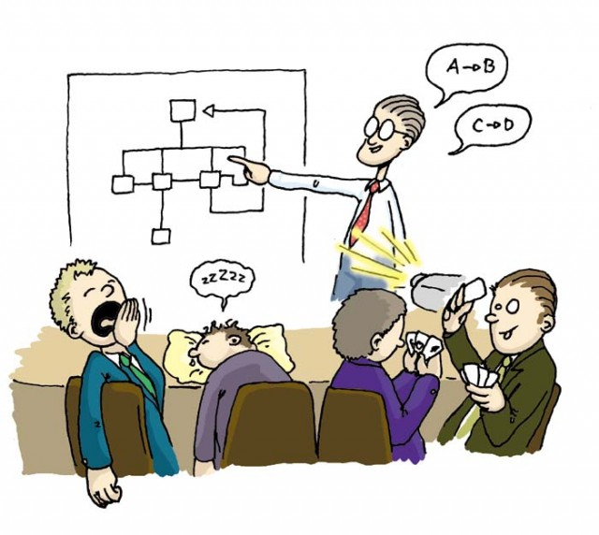
1. I Wish I Learned Practical Communication Skills

Slide 12
Common Speaking Situations
Speaking in a Meeting
Non-Tech Speaking
  Abstraction of Implementation Details
  Don’t have to kill with tech vocab even with other technical people.

Slide 13
Ways To Gain Experience
Your University Public Speaking Course
LSU Continuing Education Public Speaking
Baton Rouge Toastmasters – Organization for developing public speaking through practice
Volunteer To Speak At User Groups – They love volunteers.
If at all possible get the experience outside of a class. Much more valuable.

Slide 14
Email Communication
Do not talk like you text. No emoticons or acronyms. LOL ;-)
Email helps you document change requests.
Email helps you clarify and be clear in requirements.
Email will CYA Day to Day
Email Re-Forward Gets Slow Movers Reacting

Slide 15
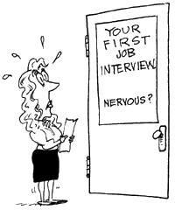
2. I Wish I Learned Resume Writing, Interviewing

Slide 16
Universities Purpose Isn’t To Get a Job
We just learn sciences.
Most of us go to work when we’re done.
Why not offer to teach it?

Slide 17
Resume Writing
Tailor the resume to the job description. Do not submit the same resume to every job.
If your experience is short don’t fill it in to make it longer. Don’t include Chili’s
School projects if experience short.
Top half of page one is most important.

Slide 18
Interviews
Most stay clueless about this for years after school.
Developers are on average so bad at interviewing it’s hard to qualify their abilities.

Slide 19
Interview Tips
Research the people interviewing you.(Linkedin, Facebook)
Shirt, tie and slacks with no cargo pants. Preferably a suit.
Bring copies of your resume.(especially if you go through a recruiter)
If you usually get a haircut get a haircut.
Be early.
Follow up.
Don’t expect a response immediately.(ever)

Slide 20
Don’t Just Barely Brush Up Before Interviews
Q: So have you used MVC any?
A: No, but I’ve read about it.
Q: Oh ok, where’d you read about it?
A: Well I noticed it on a bunch of job notices including yours.
Q: Did you try it out?
A: No, but I’m willing to learn.
*awkward embarrassing moment.* - KNOW IT

Slide 21

Everyday is Potentially an Interview

Slide 22
Turner Interview Process
All of our developers interview candidates.
I’d never interviewed someone.
Makes you a better developer because you get used to the process and can better articulate what you can do when you have to interview.

Slide 23
Be an Interviewer
If you intern or aren’t involved in the process it doesn’t hurt to ask if you can be involved in interviewing.

Slide 24
For an interview Be Able To Code Without these:
Drag and Drop
Copy / Paste
Inellisense
The Internet
Any language will typically do.
Luckily when I started interviewing people I found out I wasn’t the only one who couldn’t……

Slide 25
What Percentage Of Devs Can’t Do This?
public class PersonClass
{
public PersonClass(string firstName, string lastName)
{
this.FirstName = firstName;
this.LastName = lastName;
}
public string FirstName { get; set; }
public string LastName { get; set; }
public string FullName {
get {
return this.FirstName + ", " + this.LastName;
}
}
}
Be able to talk about code. Properties, methods, interfaces, members

Slide 26
Or This?
SELECT A.[ID], B.[Job]
FROM [FirstLongNameTableOMGITSSOLONG] A
join [SecondLongNameTableOMGWraparound] B
on A.[ID] = B.[ForeignID]
where B.[Job] is not null

Slide 27
3. I Wish We Learned Regionally Significant Topics
I wish I got to learn more about development where I planned on living.
We don’t go to school to get a job but it should be explored in university.
Couldn’t Louisiana schools teach more about development in Baton Rouge & New Orleans?

Slide 28
Where To Get Regional Information
Careerbuilder, Monster, GlassDoor.com, Linkedin
If it’s in Baton Rouge look at big local company websites. Turner, BCBSLA, Enta, Amedisys, Shaw, C&M, Ameritas, The State of Louisiana. What are they hiring for?
If Sparkhound, Antares, Envoc, and other IT specific companies/consultants are hiring for a skill then it’s in big demand.

Slide 29
Just a Little Networking Goes A Long Way
Networking at .NET user groups, SQL Saturday.
Learn local names in your industry.
  Ex. People speaking at this event.
Learn a few big names in your industry
  Ex. Microsoft Community: Scott Guthrie, Scott Hanselman, Phil Haak, Juval Lowey, Damien Edwards

Slide 30
4. I Wish I Learned To Research Constantly.
You must stay up to date in software development if you want to advance professionally.
Things change fast.

Slide 31
Ways to Stay in Touch
Magazines – Visual Studio Magazine, Redmond Channel Partner, Microsoft Certified Professional Magazine, Code Magazine
Microsoft Channel 9 Events Videos
http://channel9.msdn.com/Events/
Get on User Group Mailing Lists
Blog Subscriptions
Free Email Newsletters
Aggregators like reddit, slashdot,
Facebook Likes, Twitter Following

Slide 32
Make Time
It’s like physical fitness. Hard to make time
You have to set aside time for staying in touch.
Monday Morning For 30 Minutes – What’s New

Slide 33
5. Basic Knowledge of Project Management
The first thing that happens as a developer is people want you to estimate.
To me this is one of the most important of the 10.
No matter where you go there are project managers. Cockroaches.

Slide 34


PMI Style Project Management
Read Chapter 2 & 3 of Rita’s guide

Slide 35
5 Project Groups in PMI
Initiation - Project Charter, Stakeholders
Planning – Can We Cook The Elephant, How?
Execution – Produce the Scope.
Monitoring & Controlling – How are we doing? Changes? Back to planning.(iterative)
Closing – Confirm Documentation, Sign off. Maintenance

Slide 36
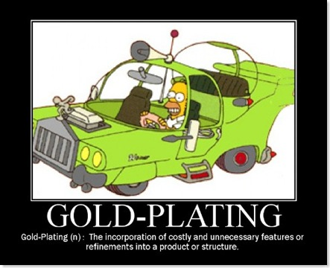
Terms Important to Developers
First off: Scope Creep, Gold Plating

Slide 37
Popular Software Development Methodologies
Waterfall – We’re all familiar with this.
Agile Development – focus on iterations.
  Scrum
  Extreme Programming
Prototyping
Development Methodologies aren’t necessarily project management methodologies.

Slide 38
Change Approval Management & Communication Plan
Should be very important to developers
Prevent Scope Creep, Gold Plating
Prevent Desk Drops by PM & Managers. They will creep their own projects and blame development later.
Prevent Gold plating includes small things like using a jquery auto load dropdown instead of a text box.(I’ll contradict myself on this)

Slide 39
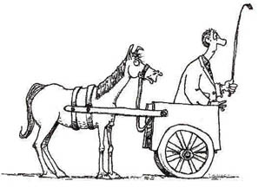
6. I Wish I Learned Design First

Slide 40
Developers Like To Jump In
We like to build as we go. It’s why we like Agile so much.

Slide 41
For Example: Prototype in to Production
Prototypes are necessary but often end up in production.
Developers fall in to a trap of creating prototypes that magically become production code.
This approach fails in larger systems.
Prototypes are simulations to identify basic requirements.
Architecture shouldn’t be married to prototypes.

Slide 42
Design it first
Would you build a building or bridge without blueprints?
We should write complete functional & technical specifications.
We should get 100% sign off of specifications

Slide 43
7. I Wish I Learned Design Patterns
Design Patterns - general reusable solution to a commonly occurring problem.

Slide 44
Why Teach Patterns in School?
A common language for building that developers can all relate to.
Can be a whole series of talks on it’s own.

Slide 45
Design Patterns & Principles
Book: Design Patterns – Elements of Reusable Object-Oriented Software
  Gang of Four Design Patterns
Book: Agile Software Development, Principles, Patterns and Practices
  S.O.L.I.D
Book: Professional ASP.NET Design Patterns

Slide 46
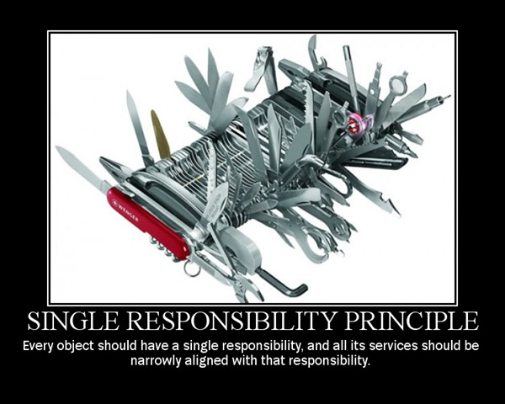
Single Responsibility Principle

Slide 47
Architectural Tools & Patterns Currently Popular
MVC / MVVM / MVP – Separation of Concerns
Service Bus & Service Oriented Architecture – Communication between applications
Data Warehousing (Data Mart), ETL – Extract, Transform, Load

Slide 48
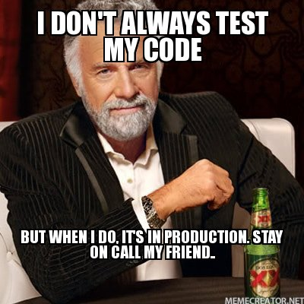
8. I Wish I Learned More On Testing

Slide 49
Common Types of Software Testing
Unit Testing – (usually as far as it goes in school)
User Acceptance Testing
Test Driven Development – Test First
Quality Assurance Groups & Departments – Whole groups of these people exist.

Slide 50
9. I Wish I learned about user id from the first
I wish I learned form the start to always consider identity.
When I was in school I never thought about this in the software we wrote.
I have yet to work on anything that didn’t involve:
    Active Directory
    SQL Server
    Citrix & Portal Type Implementations
    OpenID – Fast easy way to share information with websites.
With modern devices a distributed identity is always required to my knowledge.

Slide 51
10. I wish I Learned Not to Re-Invent the Wheel.
Using Tools & Libraries
  Jquery
  3rd party Control Venders – Infragistics, Telerik, Dev Express. Don’t write your own grid.
Using ORMs, Scaffolding Tools
  Entity Framework, Nuget
Reporting Tools rather than writing your own.
The point is look for mature products before you write your own. A product being mature and supported is important.
Can easily become gold plating. Be careful

Slide 52
</Rant>

Slide 53
Thank You!
wayne@wayneodom.com
http://www.linkedin.com/in/jerryodom
Any Questions?

